Slide 1







Deep Learning with Keras with TensorFlow

Slide 2
Deep Neural Network and Tools

Slide 3

By the end of this lesson, you will be able to:
Explain a deep neural network
Design a deep neural network step by step
Choose a loss function for a deep neural network
Describe and work with deep learning tools

Slide 4
Deep Neural Network

Slide 5
Deep Neural Network
When a neural network contains more than one hidden layer it becomes a Deep Neural Network.
Hidden Layers
Output Layer
Input Layer
Layer 1
Layer 2

Slide 6

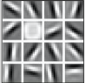
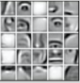
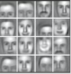
Deep Learning: Example
In deep neural network, each layer recognizes a certain set of features based on the previous layer’s output.
Hidden Layers
Layer 1
Layer 2
Layer 3
v
v
v
v
v
v
v
v
v
v
v
Robert Downey Jr.
Input Layer
Output Layer

Slide 7
Deep Learning: Example
Hidden Layers
Layer 1
Layer 2
Layer 3
v
v
v
v
v
v
v
v
v
v
v
Robert Downey Jr.
Input Layer
Output Layer
The first hidden layer trains on the
input and identifies the edges.

Slide 8
Deep Learning: Example
Hidden Layers
Layer 1
Layer 2
Layer 3
v
v
v
v
v
v
v
v
v
v
v
Robert Downey Jr.
Input Layer
Output Layer
The second hidden layer gets the identified edges as input and gives a combination of edges as an output.

Slide 9
Deep Learning: Example
Hidden Layers
Layer 1
Layer 2
Layer 3
v
v
v
v
v
v
v
v
v
v
v
Robert Downey Jr.
Input Layer
Output Layer
The third layer distinguishes different facial features that leads to the image recognition of the input.

Slide 10
Loss Function

Slide 11
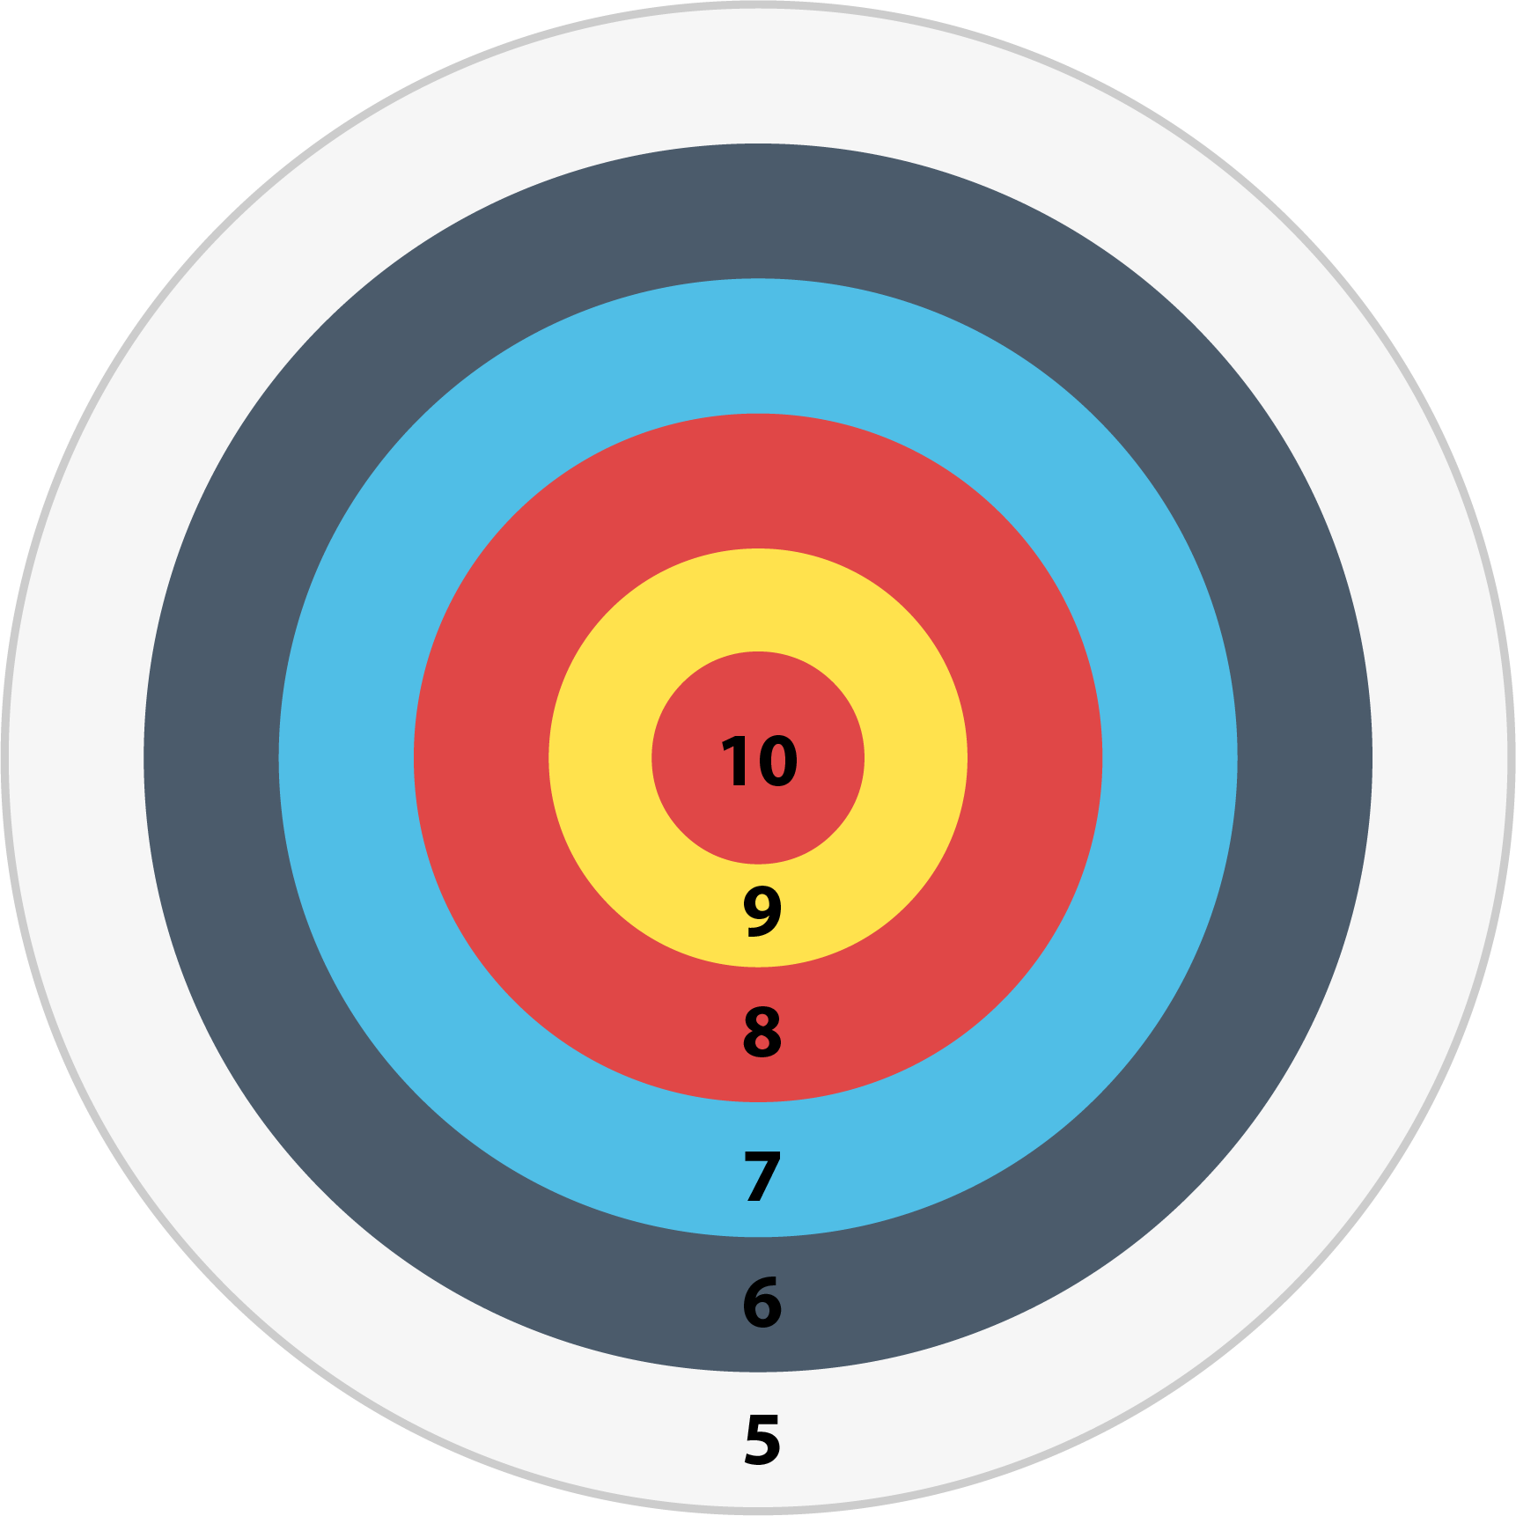
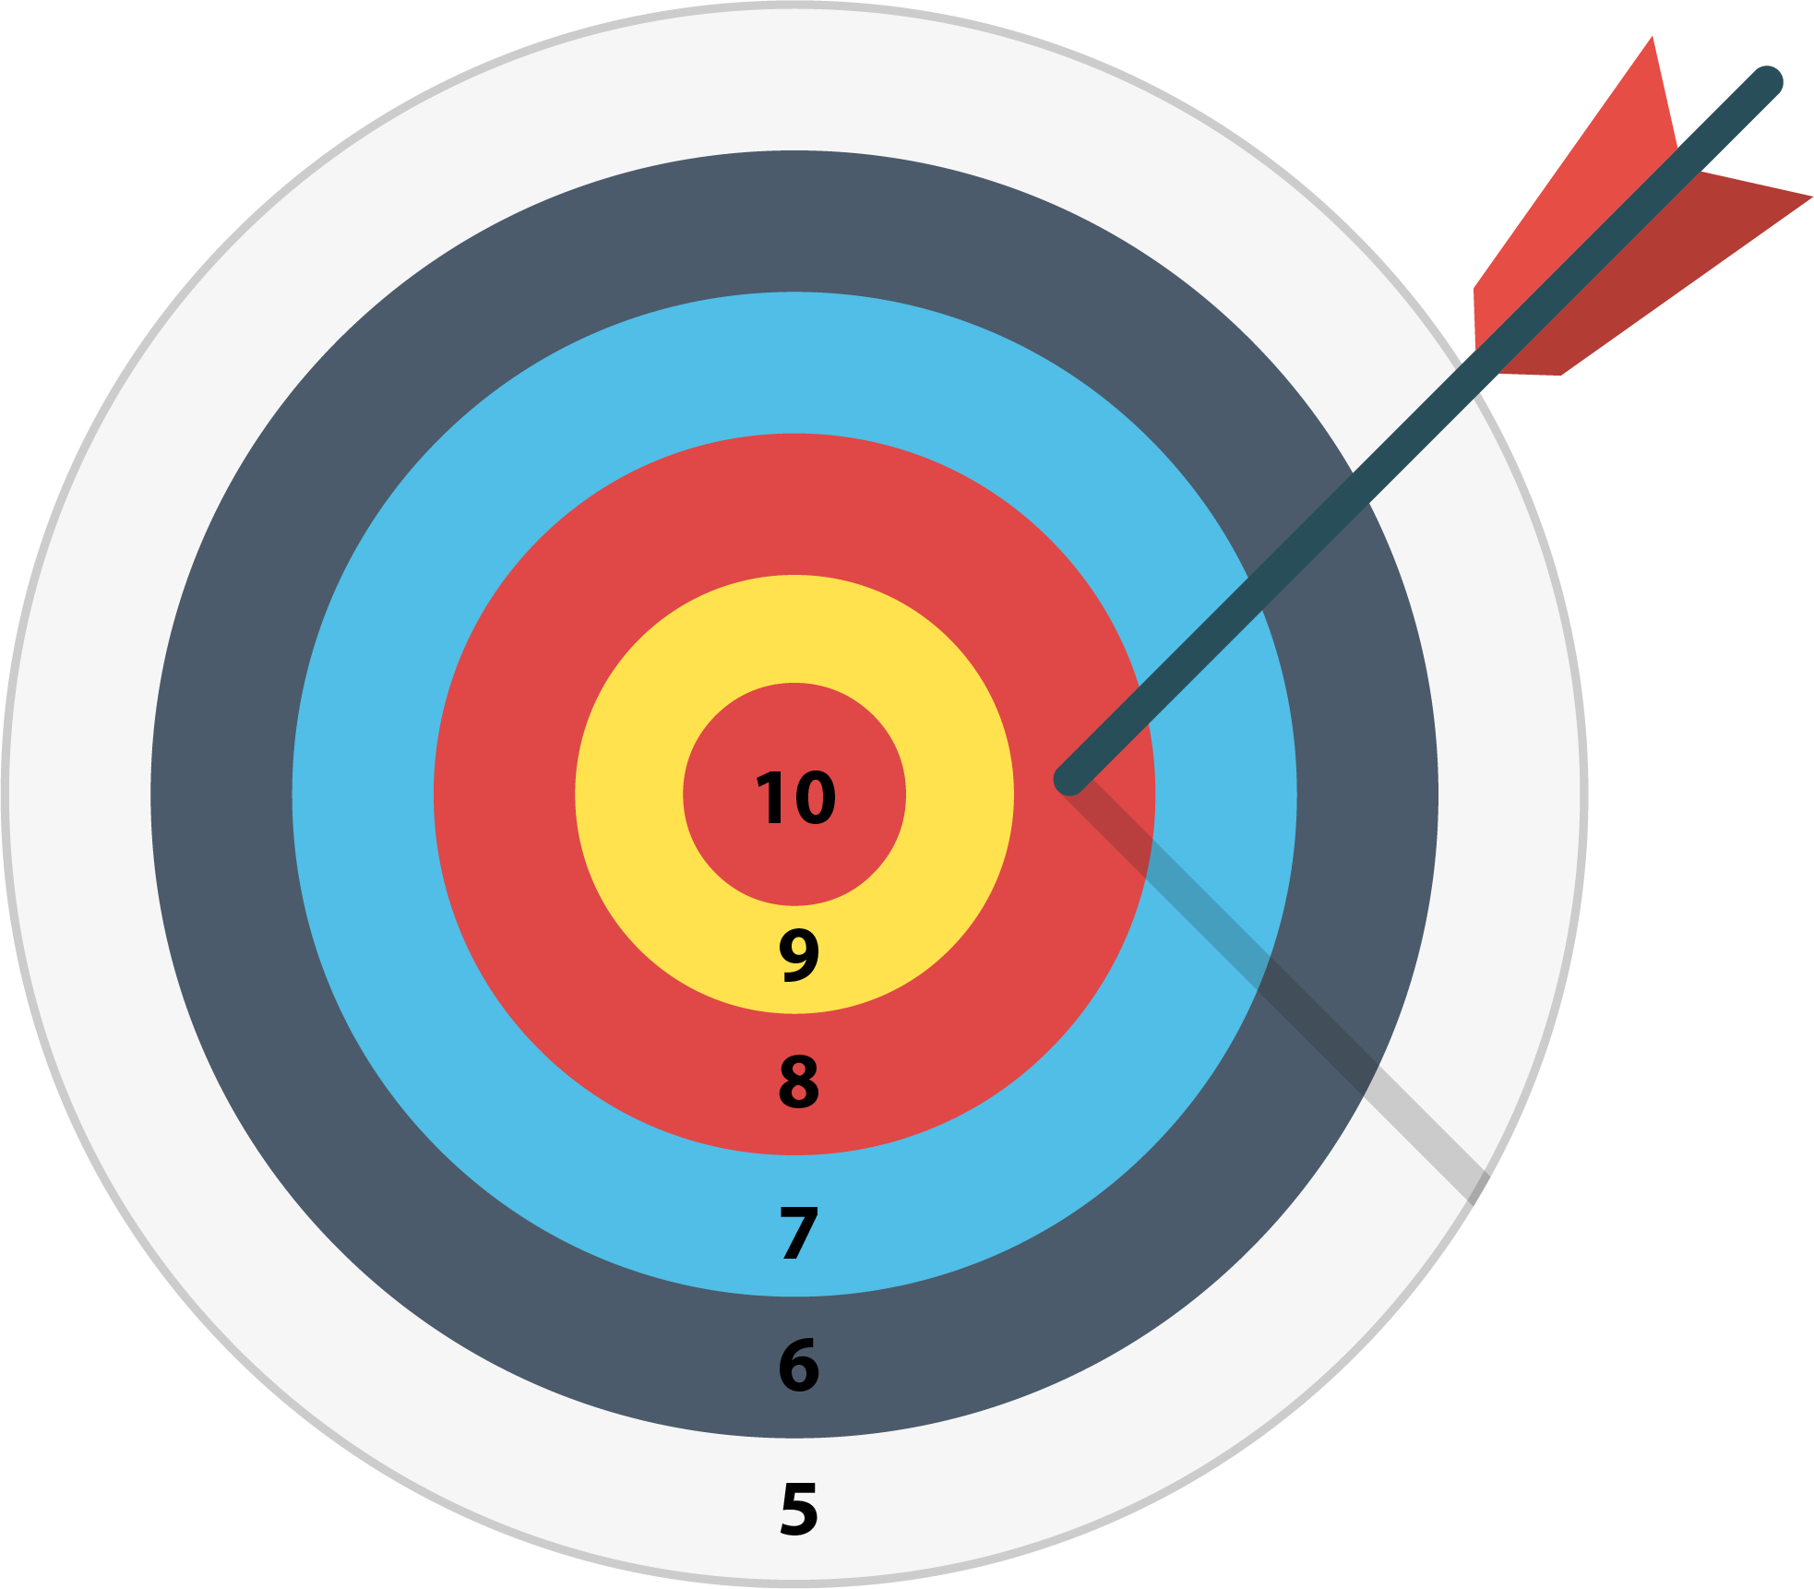
What Is Loss?
In a deep learning model, while predicting, the output deviates from the actual value, the quantitative measure of this difference is called loss. For example;
Here the actual value is 10
Arrow hit the circle with point 8
Here our loss will be, Actual value – Predicted Value, i.e., 10 – 8 = 2.

Slide 12
Loss Function and its Major Categories
The losses of deep learning models can be evaluated very easily by using Loss Function.
Loss Function
Regression Losses
Classification Losses

Slide 13
Types of Regression Losses
Regression Losses
Mean Squared Error (MSE)
Mean Absolute Error (MAE)

Slide 14

Mean Squared Error (MSE)
MSE is the average squared difference between actual and predicted value for N number of training data.
MSE = Sum of Squared Errors/N
Y (Actual Value) | Y′ (Predicted Value)
10.2 | 9.4 | 0.64
7.1 | 6.9 | 0.04
17.2 | 18.4 | 1.44
9.5 | 11.3 | 3.24
11.5 | 11.1 | 0.16
Sum |  | 5.52
MSE |  | 5.52/5 = 1.104

Slide 15
Mean Squared Error (MSE)
MAE is the absolute difference between actual and predicted value for N number of training data.
MSE = Sum of Mean Errors/N
Y (Actual Value) | Y′ (Predicted Value)
10.2 | 9.4 | 0.64
7.1 | 6.9 | 0.04
17.2 | 18.4 | 1.44
9.5 | 11.3 | 3.24
11.5 | 11.1 | 0.16
Sum |  | 5.52
MSE |  | 5.52/5 = 1.104
IY - Y′I

Slide 16
Mean Squared Error (MSE)
In MSE, since each error is squared, it penalizes even small differences in prediction when compared to MAE.
MSE = Sum of Mean Errors/N
Y (Actual Value) | Y′ (Predicted Value)
10.2 | 9.4 | 0.64
7.1 | 6.9 | 0.04
17.2 | 18.4 | 1.44
9.5 | 11.3 | 3.24
11.5 | 11.1 | 0.16
Sum |  | 5.52
MSE |  | 5.52/5 = 1.104
IY - Y′I

Slide 17
MSE or MAE?
In MSE, since each error is squared, it penalizes even small differences in prediction when compared to MAE.
Y (Actual Value) | Y′ (Predicted Value) |  | IY - Y′I
10.2 | 9.4 | 0.64 | 0.8
7.1 | 6.9 | 0.04 | 0.2
17.2 | 18.4 | 1.44 | 1.2
9.5 | 11.3 | 3.24 | 1.8
11.5 | 11.1 | 0.16 | 0.4
Sum |  | 5.52 | 4.4
Loss Function |  | MSE = 5.52/5 = 1.104 | MAE = 4.4/5 = 0.88

Slide 18
MSE or MAE?
Effect of MSE is adverse on outliers. Since each error is squared in MSE, the final MSE also increases. For example:
Y (Actual Value) | Y′ (Predicted Value) |  | IY - Y′I
10.2 | 9.4 | 0.64 | 0.8
7.1 | 6.9 | 0.04 | 0.2
17.2 | 18.4 | 1.44 | 1.2
31.5 | 11.3 | 408.04 | 20.2
11.5 | 11.1 | 0.16 | 0.4
Sum |  | 5.52 | 4.4
Loss Function |  | MSE = 415.84/5 = 83.16 | MAE = 27.2/5 = 5.44

Slide 19
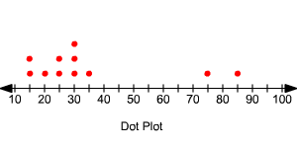
MSE or MAE?
If the data has outliers, MAE will be a better option over MSE. For data without outliers MSE is preferable.
MAE as loss function
MSE as loss function
Notes:
To be recreated

Slide 20
Types of Classification Losses
Classification Losses
Cross Entropy
Hinge Loss

Slide 21
Cross Entropy
Cross entropy is a way to calculate distance between two probability distributions. For example, Let us consider a classification problem of 3 classes.
Class(Samsung, Apple, LG)
Output = [P(Samsung), P(Apple), P(LG)]
The class with highest probability is the winner.

Slide 22
Cross Entropy
If the predicted probability distribution is not close to the actual value, the model adjusts its weight.
Samsung = [1,0,0]
Apple = [0,1,0]
LG = [0,0,1]
Output = [P(Samsung), P(Apple), P(LG)]
The actual probability
distribution for each class

Slide 23

Cross Entropy
In this scenario, cross entropy is used as a tool to calculate the difference predicted probability distribution from the actual one.
Predicted
Probability
Distribution
LG Actual
Probability
Distribution
Input
0.1
0
Samsung
Model
Apple
0.3
0
Cross Entropy
Measures distance
Between two
Distributions
LG
0.6
1
LG
Intuition behind Cross Entropy

Slide 24
Calculation Cross Entropy
The model gives the probability distribution for N classes for a particular input data C.
P(C) = [y1′ , y2′ , y3′ … yN’]
The actual or target probability distribution of the data C is:
A(C) = [y1 , y2 , y3 … yN]
Cross entropy for data C is calculated as:
CrossEntropy(A,P) = – ( y1*log(y1′) + y2*log(y2′) + y3*log(y3′) + … + yN*log(yN’) )

Slide 25
Calculation Cross Entropy
The following formula measures the cross entropy for a single observation or input data from the example:
P(LG) = [0.6, 0.3, 0.1]
A(LG) = [1, 0, 0]
CrossEntropy(A,P) = – (1*Log(0.6) + 0*Log(0.3)+0*Log(0.1)) = 0.51

Slide 26
Types of Cross Entropy
Cross Entropy
Categorical
Binary

Slide 27
Categorical Cross Entropy
Categorical Cross Entropy = Sum of Cross Entropy for N data/N
Data | Actual Probability Distribution | Predicted Probability Distribution | Cross Entropy
Samsung | [1, 0, 0] | [0.6, 0.3, 0.1] | – (1*Log(0.6) + 0*Log(0.3)+0*Log(0.1)) = 0.51
Samsung | [1, 0, 0] | [0.9, 0.1, 0] | – (1*Log(0.9) + 0*Log(0.1)+0*Log(0.1)) = 0.1
Apple | [0, 1, 0] | [0.2, 0.7, 0.1] | – (0*Log(0.2) + 1*Log(0.7)+0*Log(0.1)) = 0.35
LG | [0, 0, 1] | [0.3, 0.2, 0.5] | – (0*Log(0.3) + 0*Log(0.2)+1*Log(0.5)) = 0.69
Apple | [0, 1, 0] | [0.6, 0.1, 0.3] | – (0*Log(0.6) + 1*Log(0.1)+0*Log(0.3)) = 2.3
Samsung | [1, 0, 0] | [0.5, 0.2, 0.3] | – (1*Log(0.5) + 0*Log(0.2)+0*Log(0.3)) = 0.69
LG | [0, 0, 1] | [0.1, 0.1, 0.8] | – (0*Log(0.1) + 0*Log(0.1)+1*Log(0.8)) = 0.22
Loss Function |  |  | (0.51 + 0.1 + 0.35 + 0.69 + 2.3 + 0.69 + 0.22) / 7 = 4.76

Slide 28
Binary Cross Entropy
Binary cross entropy assumes a binary value of 0 or 1 to denote negative and positive class respectively, when there is only one output.
The actual output is denoted by a single variable y, then cross entropy for a particular data C can be simplified as follows:
Cross Entropy(C) = – y*log(y’) when y = 1
Cross Entropy(C) = – (1-y)*log(1-y’) when y = 0
The error in binary classification for complete model is given by binary cross entropy which is nothing but the mean of cross entropy for N data.
Binary Cross Entropy = Sum of Cross Entropy for N data/N

Slide 29


Cross Entropy over MSE/MAE
Overconfident wrong prediction occurs when MSE/MAE is used in classification, especially during the training phase.
Congrats, our model says you are pregnant.
????

Slide 30
Cross Entropy over MSE/MAE
Let us see how binary cross entropy, MAE and MSE penalizes in such situation.
In the example below, the two scenarios of y = 1, y’ = 0.2 and y = 0, y’ = 0.8 are examples of wrong classification.
Scenario | Actual y’ | Predicted y | MAE | MSE | Binary Cross Entropy
Prediction is confidently closer to actual class 1 | 1 | 0.9 | I1 - 0.9I = 0.1 |  | – 1*Log(0.9) = 0.1
Prediction is confidently closer to actual class 0 | 1 | 0.2 | I1 - 0.2I = 0.8 |  | – 1*Log(0.2) = 1.64
Prediction is confidently closer to actual class 0 | 0 | 0.1 | I0 - 0.1I = 0.1 |  | – 1*Log(1 - 0.1) = 0.1
Prediction is confidently closer to actual class 1 | 0 | 0.8 | I0 - 0.8I = 0.8 |  | – 1*Log(1 – 0.8) = 1.64
Binary Cross Entropy penalizes more severely than MAE or MSE.

Slide 31
TensorFlow

Slide 32
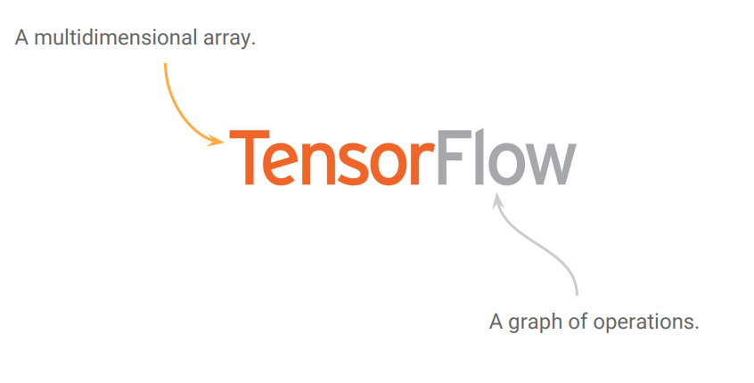
What Is TensorFlow?

Slide 33

What Is TensorFlow?
A popular open source library for deep learning and machine learning
Developed by Google Brain Team and released in 2015
Used mainly for classification, perception, understanding, discovering, prediction, and creation

Slide 34
What Is TensorFlow?
TensorFlow uses a dataflow graph to represent your computation.
Dataflow is a common programming model for parallel computing.

Slide 35
Benefits of Using Graph
Parallelism
It is easy for the system to identify operations that can be executed parallelly.
Distributed Execution
It is possible for TensorFlow to partition your program across multiple devices CPUs, GPUs, and TPUs.
Compilation
It helps to generate faster code.
Portability
You can build a dataflow graph in Python, store it in a saved model, and restore it in a C++ program.

Slide 36
Why TensorFlow?
Flexibility
Parallel Computation
Multiple Environment Friendly
Large Community
Windows

Slide 37

TensorFlow: Parallel Computation
TensorFlow supports distributed computing.

Slide 38


TensorFlow: Flexibility
Python API offers flexibility to create all sorts of computations for every neural network architecture
Includes highly efficient C++ implementations of many ML operations

Slide 39
TensorFlow: Multiple Environment Friendly
Runs on desktop and mobile devices such as:
Linux
macOS
iOS
Android
Raspberry Pi
Windows

Slide 40
TensorFlow: Large Community
Is one of the most popular open source projects on GitHub
Has a dedicated team of passionate and helpful developers
Has a growing community contributing to improve it

Slide 41
Installation of TensorFlow
TensorFlow 2 packages require a pip version >19.0.
pip install --upgrade pip

Slide 42
TFLearn

Slide 43


What Is TFLearn?
TFlearn is a modular and transparent deep learning library built on top of Tensorflow. It was designed to provide a higher-level API to TensorFlow in order to facilitate and speed up experimentations, while remaining fully transparent and compatible with it.

Slide 44
Features of TFLearn
Easy to use, understand, and implement
Fast prototyping through highly modular built-in components
Full transparency over Tensorflow
Powerful helper functions to train any TensorFlow graph
Easy and clear graph visualization
Effortless device placement for using multiple CPU or GPU

Slide 45
Installation of TFLearn
For the bleeding edge version:
pip install git+https://github.com/tflearn/tflearn.git
For the latest stable version:
pip install tflearn

Slide 46
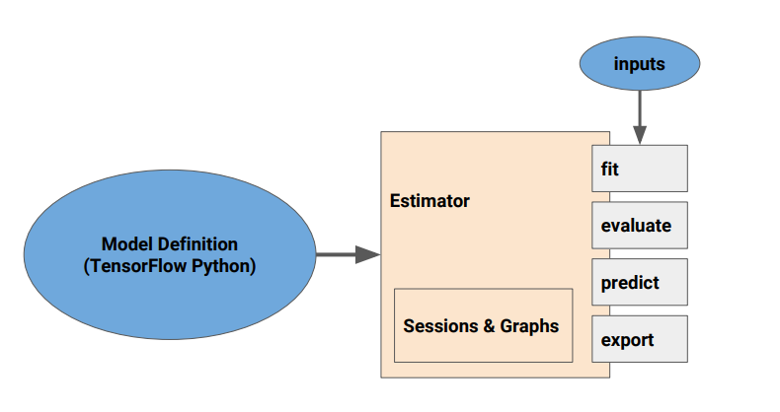
TFLearn Model
Notes:
Inputs, fit, evaluate, predict and export will be in title case to be recreated by GD as well as the & to and

Slide 47
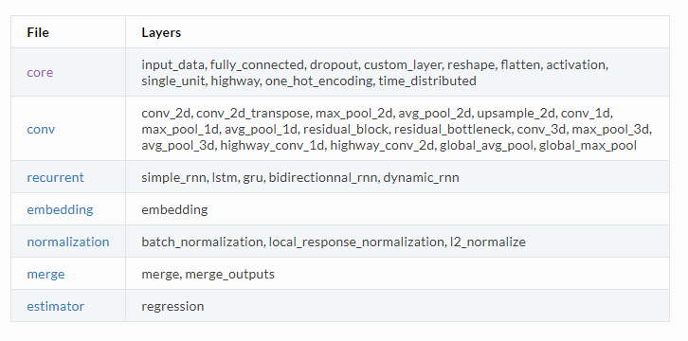
Layers of TFLearn
Currently available layers of TFLearn are:

Slide 48
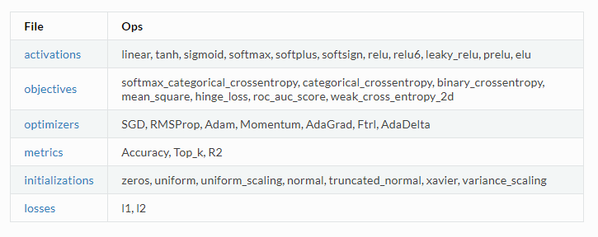
Built-In Operations of TFlearn

Slide 49
Training of TFLearn
Training functions are another core feature of TFLearn. In Tensorflow, there are no prebuilt API to train a network, so TFLearn integrates a set of functions that can easily handle any neural network training, for any number of inputs, outputs, and optimizers.

Slide 50
Visualization
TFLearn has the ability to manage a lot of useful logs. Currently, TFLearn supports a verbose level to automatically manage summaries:
1: Loss and Metric (Best Speed)
2: Loss, Metric, and Gradients
3: Loss, Metric, Gradients, and Weights
4: Loss, Metric, Gradients, Weights, Activations, and Sparsity (Best Visualization)
Effortless device placement for using multiple CPU or GPU

Slide 51
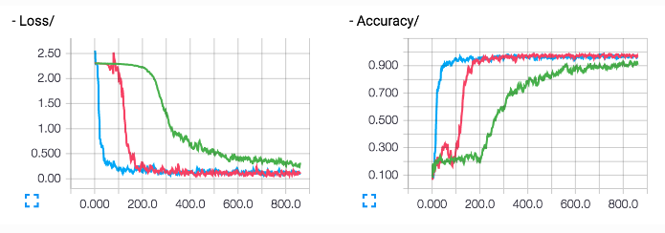
Visualization: Loss and Accuracy

Slide 52
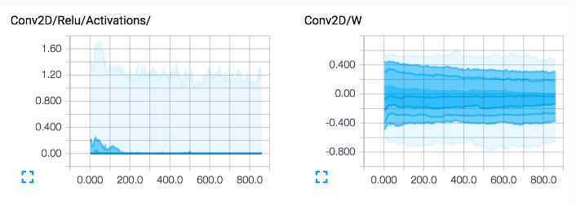
Visualization: Layers

Slide 53
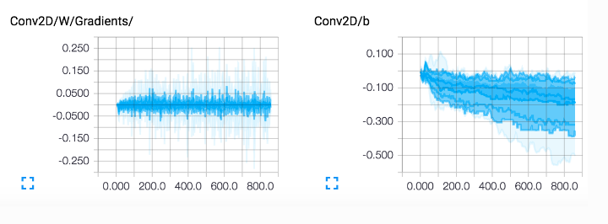
Visualization: Layers

Slide 54
Weights Persistence
To save or restore a model, use 'save' or 'load' method of DNN model class.
Code
# Save a model
model.save('my_model.tflearn')
# Load a model
model.load('my_model.tflearn')

Slide 55
Weights Persistence
Retrieving a layer variable can either be done using the layer name, or directly by using 'W' or 'b' attributes that are supercharged to the layer's returned tensor.
Code
# Let's create a layer
fc1 = fully_connected(input_layer, 64, name="fc_layer_1")
# Using Tensor attributes (Layer will supercharge the returned Tensor with weights attributes)
fc1_weights_var = fc1.W
fc1_biases_var = fc1.b
# Using Tensor name
fc1_vars = tflearn.get_layer_variables_by_name("fc_layer_1")
fc1_weights_var = fc1_vars[0]
fc1_biases_var = fc1_vars[1]

Slide 56
Weights Persistence
To get or set the value of these variables, TFLearn model classes implement get_weight and set_weights methods:
Code
input_data = tflearn.input_data(shape=[None, 784])
fc1 = tflearn.fully_connected(input_data, 64)
fc2 = tflearn.fully_connected(fc1, 10, activation='softmax')
net = tflearn.regression(fc2)
model = DNN(net)
# Get weights values of fc2
model.get_weights(fc2.W)
# Assign new random weights to fc2
model.set_weights(fc2.W, numpy.random.rand(64, 10))

Slide 57
Fine-Tuning
While defining a model in TFLearn, you can specify the layer's weights while loading the pre-trained model. This can be handled by the restore argument of layer functions and it is only available for layers with weights.
Code
# Weights will be restored by default.
fc_layer = tflearn.fully_connected(input_layer, 32)
# Weights will not be restored, if specified so.
fc_layer = tflearn.fully_connected(input_layer, 32, restore='False')

Slide 58
Data Management
TFLearn supports numpy array data. Additionally, it supports HDF5 for handling large datasets. TFLearn can directly use HDF5-formatted data:
Code
# Load hdf5 dataset
h5f = h5py.File('data.h5', 'r')
X, Y = h5f['MyLargeData']
... define network ...
# Use HDF5 data model to train model
model = DNN(network)
model.fit(X, Y)

Slide 59
Data Preprocessing and Augmentation
Data Preprocessing and Data Augmentation
TFLearn provides wrappers to easily handle data preprocessing and data augmentation. TFLearn data stream is designed with computing pipelines in order to speedup training by pre-processing data on CPU while GPU is performing model training.
Code
# Load hdf5 dataset
h5f = h5py.File('data.h5', 'r')
X, Y = h5f['MyLargeData']
... define network ...
# Use HDF5 data model to train model
model = DNN(network)
model.fit(X, Y)

Slide 60
Data Preprocessing and Augmentation
Code
# Real-time image preprocessing
img_prep = tflearn.ImagePreprocessing()
# Zero Center (With mean computed over the whole dataset)
img_prep.add_featurewise_zero_center()
# STD Normalization (With std computed over the whole dataset)
img_prep.add_featurewise_stdnorm()

Slide 61
Data Preprocessing and Augmentation
Code
# Real-time data augmentation
img_aug = tflearn.ImageAugmentation()
# Random flip an image
img_aug.add_random_flip_leftright()
# Add these methods into an 'input_data' layer
network = input_data(shape=[None, 32, 32, 3],
data_preprocessing=img_prep,
data_augmentation=img_aug)

Slide 62
Scopes and Weights Sharing
All layers are built over variable_op_scope, that makes them easy to share the variables among multiple layers and make TFLearn suitable for distributed training.
Code
# Define a model builder
def my_model(x):
x = tflearn.fully_connected(x, 32, scope='fc1')
x = tflearn.fully_connected(x, 32, scope='fc2')
x = tflearn.fully_connected(x, 2, scope='out')
# 2 different computation graphs but sharing the same weights
with tf.device('/gpu:0'):
# Force all Variables to reside on the CPU.
with tf.arg_scope([tflearn.variables.variable], device='/cpu:0'):
model1 = my_model(placeholder_X)

Slide 63
Scopes and Weights Sharing
All layers with inner variables support a scope argument to place variables under layers with same scope name and these layers share the same weights.
Code
# Reuse Variables for the next model
tf.get_variable_scope().reuse_variables()
with tf.device('/gpu:1'):
with tf.arg_scope([tflearn.variables.variable], device='/cpu:0'):
model2 = my_model(placeholder_X)
# Model can now be trained by multiple GPUs (see gradient averaging)

Slide 64
Graph Initialization
It is useful to limit resources, or assign more or less GPU RAM memory while training. To do so, a graph initializer can be used to configure a graph by running the following:
Code
tflearn.init_graph(set_seed=8888, num_cores=16, gpu_memory_fraction=0.5)

Slide 65
Extending TensorFlow
TFLearn is a very flexible library designed to let you use any of its component independently. A model can be succinctly built using any combination of Tensorflow operations and TFLearn built-in layers and operations. The following are the two basic fields where TensorFlow is extended:
Layers
Built-In Operations

Slide 66
Extending TensorFlow: Layers
Any layer can be used with any other tensor from Tensorflow, i.e. you can directly use TFLearn wrappers into your own Tensorflow graph.
Code
# Some operations using Tensorflow.
X = tf.placeholder(shape=(None, 784), dtype=tf.float32)
net = tf.reshape(X, [-1, 28, 28, 1])
# Using TFLearn convolution layer.
net = tflearn.conv_2d(net, 32, 3, activation='relu')
# Using Tensorflow's max pooling op.
net = tf.nn.max_pool(net, ksize=[1, 2, 2, 1], strides=[1, 2, 2, 1], padding='SAME')

Slide 67
Extending TensorFlow: Built-In Operations
TFLearn built-in operations make Tensorflow graph writing faster and more readable. These are fully compatible with any TensorFlow expression. The following code examples show how to use them along with pure Tensorflow API.

Slide 68
Trainer, Evaluator, and Predictor
TFLearn provides some helpers function that can train any Tensorflow graph. It is suitable to make training more convenient, by introducing real-time monitoring, batch sampling, moving averages, tensorboard logs, data feeding, etc. It supports any number of inputs, outputs, and optimization ops.
TFLearn implements a TrainOp class to represent an optimization process (i.e. backprop). It is defined as follows:
Code
trainop = TrainOp(net=my_network, loss=loss, metric=accuracy)

Slide 69
Trainer, Evaluator, and Predictor
TrainOps can be fed into a Trainer class, that will handle the whole training process, considering all TrainOp together as a whole model.
Code
model = Trainer(trainops=trainop, tensorboard_dir='/tmp/tflearn')
model.fit(feed_dict={input_placeholder: X, target_placeholder: Y})

Slide 70
Trainer, Evaluator, and Predictor
TFLearn models are useful for more complex models to handle multiple optimization.
Code
model = Trainer(trainops=[trainop1, trainop2])
model.fit(feed_dict=[{in1: X1, label1: Y1}, {in2: X2, in3: X3, label2: Y2}])

Slide 71
Trainer, Evaluator, and Predictor
For prediction, TFLearn implements an Evaluator class that works same as the trainer. It takes a parameter and returns the predicted value.
Code
model = Evaluator(network)
model.predict(feed_dict={input_placeholder: X})

Slide 72
Trainer, Evaluator, and Predictor
To handle networks that have layer with different behaviors at training and testing time such as dropout and batch normalization:
Trainer class uses a Boolean variable (is_training), that specifies if the network is used for training or testing or predicting. This variable is stored under tf.GraphKeys.IS_TRAINING collection, as its first element. So, while defining such layers, this variable should be used as the operational condition:
Code
# Example for Dropout:
x = ...
def apply_dropout(): # Function to apply when training mode ON.
return tf.nn.dropout(x, keep_prob)
is_training = tflearn.get_training_mode() # Retrieve is_training variable.
tf.cond(is_training, apply_dropout, lambda: x) # Only apply dropout at training time.

Slide 73

What Is Keras?
A high-level neural network API, written in Python
Most powerful and easy to use for developing and evaluating deep learning models
Runs seamlessly on CPU and GPU

Slide 74
Keras: Backends
Keras uses TensorFlow, Theano, MxNet, and CNTK (Microsoft) as backends.
Keras
TensorFlow, MxNet, CNTK,Theano
CPU
GPU
TPU

Slide 75
Why Use Keras?
Allows easy and fast prototyping
Supports both convolutional networks, recurrent networks, and
combination of both
Provides clear and actionable feedback for user error
Follows best practices for reducing cognitive load

Slide 76
Installation of Keras
Installation of Keras is done as follows:
Install Keras in virtualenv:
pip3 install keras
Install Keras from the GitHub source:
Clone Keras using git:
git clone https://github.com/keras-team/keras.git
cd to the Keras folder and run the install command:
cd keras
sudo python setup.py install

Slide 77
Creating a Keras Model
1
Architecture Definition: Number of layers, number of nodes in layers, and activation function to be used
2
Compile: Defines the loss function and details about how optimization works
3
Fit: Finalizes the model through back propagation and optimization of weights with input data
4
Predict: Predicts with the model prepared

Slide 78
Create the Model
The sequential model is a linear stack of layers.
Code
model = Sequential()
Model.add(Convolution2D(16, 5, 5, activation='relu', input_shape=(img_width, img_height, 3)))
model.add(MaxPooling2D(2, 2))
model.add(Convolution2D(32, 5, 5, activation='relu'))
model.add(MaxPooling2D(2, 2))
model.add(Flatten())
model.add(Dense(1000, activation='relu'))
model.add(Dense(10, activation='softmax'))

Slide 79
Compile the Model
Code
model.compile(loss='binary_crossentropy', optimizer='adam', metrics=['accuracy'])
The loss function evaluates a set of weights.
The optimizer searches through different weights for the network and optional metrics to collect and report during training.
Set metrics=[‘accuracy’] for classification problem.

Slide 80
Fit the Model
Code
model.fit(x_train, y_train,
batch_size=batch_size,
epochs=epochs,
verbose=1,
validation_data=(x_test, y_test))
Executes model for some data
Trains and iterates data in batches

Slide 81
Evaluate the Model
Code
score = model.evaluate(x_test, y_test, verbose=0)
print('Test loss:', score[0])
print('Test accuracy:', score[1])
Assesses the modeled data set

Slide 82
Predict
Code
classes=model.predict(x_test,batch_size=128)
Generates prediction on new data

Slide 83
Other Deep Learning Tool: PyTorch

Slide 84

What Is PyTorch?
A deep learning research platform that provides maximum flexibility and speed
A replacement for NumPy to use the power of GPUs
A product of Facebook's artificial intelligence team

Slide 85
Features of PyTorch
The features of Pytorch is as follows:
Simple Interface
Hybrid Frontend
Distributed Training
Native ONNX Support
C++ Frontend
Cloud Partners

Slide 86
PyTorch Ecosystems
Glow, an ML compiler increases the performance of deep learning platform.
PyTorch Geometric, a library for deep learning for irregular input data.
Skorch, high-level library provides full scikit-learn compatibility.
Torchbearer, a library for advanced visualizations.

Slide 87
Installation of PyTorch
Configurations followed to install PyTorch:
PyTorch Build
Stable(1.2)
Preview (Nightly)
Your OS
Linux
MAC
Windows
Package
Conda
Pip
LibTorch
Source
Language
Python 2.7
Python 3.5
Python 3.6
Python 3.7
C++
CUDA
9.2
10.0
None
Run this
command
Conda install pytorch torchvision cudotoolkit = 10.0 –c pytorch

Slide 88
Deep Learning Model with Keras
Problem Statement: A data set is given of diabetes patients with different health parameters make a deep learning classification model to predict.
Access:
Click on the Labs tab on the left side panel of the LMS. Copy the username and password.
Click on the Launch Lab button. On the page that appears, enter the username and password, and click Login.

Slide 89
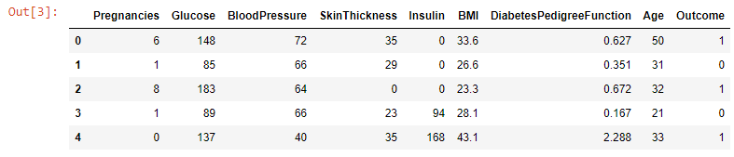
Loading Dataset
Processing the Data
The dataset is read first by using pandas library and the first five line of the dataset is printed.
Define the Model
Code
Compile the Model
import pandas as pd
dataset = pd.read_csv('diabetes.csv')
Dataset.head()
Fit the Model
Evaluate the Model
Predict

Slide 90
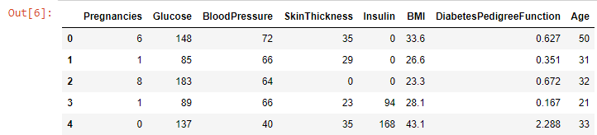
Splitting Dataset
Processing the Data
The dataset is split into input and output.
Define the Model
Code
Compile the Model
X = dataset.iloc[:,0:8]
y = dataset.iloc[:, 8]
X.head()
Fit the Model
Evaluate the Model
Predict

Slide 91
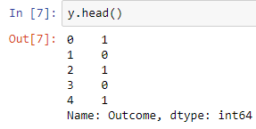
Splitting Dataset
Processing the Data
The dataset is split into input and output.
Define the Model
Code
Compile the Model
Y.head()
Fit the Model
Evaluate the Model
Predict

Slide 92
Importing Library
Processing the Data
The model is sequential and the layers are defined with Dense class.
Define the Model
Compile the Model
Fit the Model
Code
from keras.models import Sequential
from keras.layers import Dense
Evaluate the Model
Predict

Slide 93
Creating the Layers
Layer structure of the model:
The model expects rows of data with eight variables (the input_dim=8 argument).
The first hidden layer has 12 nodes and uses the ReLU activation function.
The second hidden layer has 8 nodes and uses the ReLU activation function.
The output layer has one node and uses the sigmoid activation function.
Processing the Data
Define the Model
Compile the Model
Fit the Model
Evaluate the Model
Predict
Code
model = Sequential()
model.add(Dense(12, input_dim=8, activation='relu'))
model.add(Dense(8, activation='relu'))
model.add(Dense(1, activation='sigmoid'))

Slide 94
Compile the Model
Processing the Data
Binary Cross Entropy is set as loss function for this classification model
The optimizer is Adam algorithm
The metrics is set to accuracy
Define the Model
Compile the Model
Fit the Model
Code
Evaluate the Model
model.compile(loss='binary_crossentropy', optimizer='adam', metrics=['accuracy'])
Predict

Slide 95
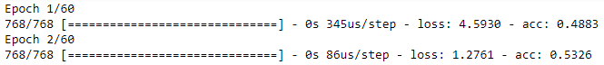
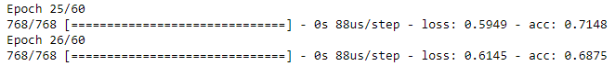
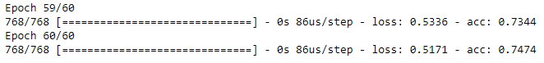
Fit the Model
Processing the Data
Training occurs over epochs and each epoch is split into batches.
Define the Model
Compile the Model
Code
Fit the Model
model.fit(X, y, epochs=60, batch_size=10)
Evaluate the Model
Predict

Slide 96
Evaluate the Model
Processing the Data
The priority of this demo is only the second part of the evaluate() function, i.e, accuracy.
Define the Model
Compile the Model
Fit the Model
Code
_, accuracy = model.evaluate(X, y)
print('Accuracy: %.2f' % (accuracy*100))
Evaluate the Model
Predict

Slide 97
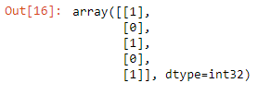
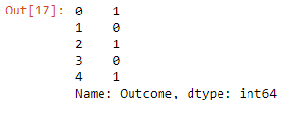
Predict
The predict_classess() generate class predictions for the input.
Processing the Data
Code
Define the Model
predictions = model.predict_classes(X)
predictions[0:5]
Compile the Model
Fit the Model
Evaluate the Model
Predict
dataset['Outcome'].head()

Slide 98
Deep Learning Model with TensorFlow
Problem Statement: Create a deep learning model with MNIST dataset to predict the handwritten digits.
Access:
Click on the Labs tab on the left side of the LMS panel. Copy the username and password.
Click on the Launch Lab button. On the page that appears, enter the username and password, and click Login.

Slide 99
Loading the Dataset
Import tensorflow, and load the MNIST, dataset of handwritten digits, 0 to 9 of image with dimension 28x28
Processing the Data
Define the Model
Compile the Model
Code
Fit the Model
import tensorflow as tf
mnist_data = tf.keras.datasets.mnist
x_train, y_train),(x_test, y_test) = mnist_data.load_data()
Evaluate the Model
Predict

Slide 100
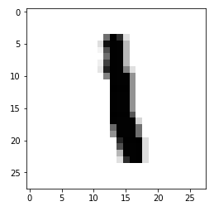
Visualizing the Data
The digit at the position 6 is printed using matplotlib library.
Processing the Data
Code
Define the Model
import matplotlib.pyplot as plt
plt.imshow(x_train[6],cmap=plt.cm.binary)
plt.show()
Compile the Model
Fit the Model
Evaluate the Model
Predict
print(y_train[6])

Slide 101
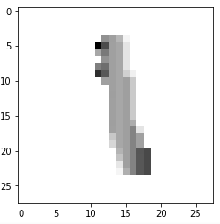
Normalizing the Data
Data normalization is achieved by tensorflow.keras.utils.normalize() function, and the pixel of the images is normalized from the range 0 to 255 to the range 0 to 1.
Processing the Data
Define the Model
Code
Compile the Model
x_train = tf.keras.utils.normalize(x_train, axis=1)
x_test = tf.keras.utils.normalize(x_test, axis=1)
Fit the Model
Evaluate the Model
Predict
The difference can be seen between original digit and normalized digit.

Slide 102
Define the Model
A feed forward sequential model is defined:
Flattening the input layer from 28*28 to 1*128
Applying two densely connected layer with rectified linear as activation function
In the final layer, there are 10 nodes, one node for each digit. The activation function is softmax, perfect when desired output is probability distribution of the event over ‘n’ different events
Processing the Data
Define the Model
Compile the Model
Fit the Model
Code
Evaluate the Model
Predict
model = tf.keras.models.Sequential()
model.add(tf.keras.layers.Flatten())
model.add(tf.keras.layers.Dense(128, activation=tf.nn.relu))
model.add(tf.keras.layers.Dense(128, activation=tf.nn.relu))
model.add(tf.keras.layers.Dense(10,activation=tf.nn.softmax))

Slide 103
Compile the Model
Sparse Categorical Cross Entropy is set as loss function for this classification model.
The optimizer is Adam algorithm, straightforward to implement, and gives efficient result.
The metrics is set to accuracy.
Processing the Data
Define the Model
Compile the Model
Fit the Model
Code
Evaluate the Model
model.compile(optimizer='adam',
loss='sparse_categorical_crossentropy',
metrics=['accuracy'])
Predict

Slide 104
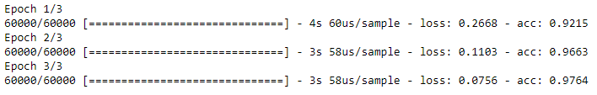
Fit the Model
Processing the Data
Training occurs over epochs and each epoch is split into batches.
Define the Model
Compile the Model
Code
model.fit(x_train, y_train, epochs=3)
Fit the Model
Evaluate the Model
Predict

Slide 105
Evaluate the Model
Processing the Data
The evaluate() function returns a list with two values. The first is the loss of the model on the data set, and the second is the accuracy of the model on the dataset.
Define the Model
Compile the Model
Code
Fit the Model
loss, accuracy = model.evaluate(x_test, y_test)
print(loss)
print(accuracy)
Evaluate the Model
Predict

Slide 106
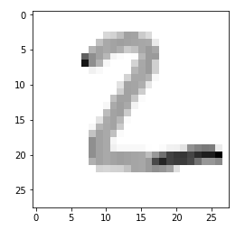
Predict
The predict() function predicts the digit for the input.
Processing the Data
Code
Define the Model
predictions = model.predict(x_test)
import numpy as np
print(np.argmax(predictions[1]))
Compile the Model
Fit the Model
Evaluate the Model
plt.imshow(x_test[1],cmap=plt.cm.binary)
plt.show()
Predict

Slide 107
Deep Learning Model with Keras
Problem Statement: Build a deep learning model using Fashion-MNIST, dataset of fashion articles with 10 classes and each image is 28*28 pixel.
Access:
Click on the Labs tab on the left side of the LMS panel. Copy the username and password.
Click on the Launch Lab button. On the page that appears, enter the username and password, and click Login.

Slide 108
Importing the Library
Processing the Data
Building the Network
Define Loss Function and Optimizer
Code
Train the Network
import torch
import torchvision
import torchvision.transforms as transforms
Evaluate the Model

Slide 109
Creating Image Normalizer
An object is created using Compose() function to normalize the image data.
Processing the Data
Building the Network
Define Loss Function and Optimizer
Code
Train the Network
transform = transforms.Compose([transforms.ToTensor(),
transforms.Normalize((0.5,), (0.5,))])
Evaluate the Model

Slide 110
Creating Data Loader
Processing the Data
Creating data loader object for training data:
Building the Network
Code
Define Loss Function and Optimizer
traindata = torchvision.datasets.FashionMNIST(root='./data', train=True,
download=True, transform=transform)
trainloader = torch.utils.data.DataLoader(traindata, batch_size=4,
shuffle=True)
Train the Network
Evaluate the Model

Slide 111
Creating Data Loader
Processing the Data
Creating data loader object for testing data:
Building the Network
Code
Define Loss Function and Optimizer
testdata = torchvision.datasets.FashionMNIST(root='./data', train=False,
download=True, transform=transform)
testloader = torch.utils.data.DataLoader(testdata, batch_size=4,
shuffle=False)
Train the Network
Evaluate the Model

Slide 112
Visualizing the Image Data
Processing the Data
Code
Building the Network
import matplotlib.pyplot as plt
import numpy as np
def show_image(image):
image = image / 2 + 0.5 # unnormalize
np_img = image.numpy()
plt.imshow(np.transpose(np_img, (1, 2, 0)))
Define Loss Function and Optimizer
Train the Network
Evaluate the Model

Slide 113
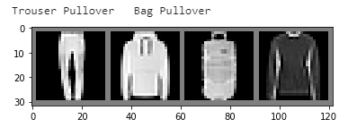
Visualizing the Image Data
Code
Processing the Data
dataiter = iter(trainloader)
images, labels = dataiter.next()
show_image(torchvision.utils.make_grid(images))
print(' '.join('%5s' % classes[labels[j]] for j in range(4)))
Building the Network
Define Loss Function and Optimizer
Train the Network
Evaluate the Model

Slide 114
Building the Network
Code
Processing the Data
import torch.nn as nn
import torch.nn.functional as F
class Network(nn.Module):
def __init__(self):
super().__init__()
self.fc1 = nn.Linear(784, 128)
self.fc2 = nn.Linear(128, 64)
self.fc3 = nn.Linear(64, 10)
def forward(self, x):
x = x.view(x.shape[0], -1)
x = self.fc1(x)
x = F.relu(x)
x = self.fc2(x)
x = F.relu(x)
x = self.fc3(x)
x = F.softmax(x, dim=1)
return x
Building the Network
Define Loss Function and Optimizer
Train the Network
Evaluate the Model

Slide 115
Define Loss Function and Optimizer
Processing the Data
Cross entropy is set as loss function for this classification model.
The optimizer is Adam algorithm.
Building the Network
Define Loss Function and Optimizer
Code
Train the Network
from torch import optim
model = Network()
criterion = nn.CrossEntropyLoss()
optimizer = optim.Adam(model.parameters(), lr=0.1)
Evaluate the Model

Slide 116
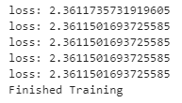
Train the Network
Code
Processing the Data
for epoch in range(5):
running_loss = 0.0
for inputs, labels in trainloader:
output = model(inputs)
loss = criterion(output, labels)
optimizer.zero_grad()
loss.backward()
optimizer.step()
running_loss += loss.item()
else:
print(f"loss: {running_loss/len(trainloader)}")
print('Finished Training')
Building the Network
Define Loss Function and Optimizer
Train the Network
Evaluate the Model

Slide 117
Train the Network
Code
Processing the Data
correct = 0
total = 0
with torch.no_grad():
for data in testloader:
images, labels = data
outputs = model(images)
_, predicted = torch.max(outputs.data, 1)
total += labels.size(0)
correct += (predicted == labels).sum().item()
print('Accuracy of the network on the 10000 test images: %d %%' % (
100 * correct / total))
Building the Network
Define Loss Function and Optimizer
Train the Network
Evaluate the Model

Slide 118
Deep Learning Model with Caffe2
Problem Statement: Make a deep learning model with MNIST data using Caffe2.
Access:
Click on the Labs tab on the left side of the LMS panel. Copy the username and password.
Click on the Launch Lab button. On the page that appears, enter the username and password, and click Login.

Slide 119
Loading the Data
Code
Loading the Data
from keras.datasets.mnist import load_data
(trainX, trainy), (testX, testy) = load_data()
print('Train', trainX.shape, trainy.shape)
print('Test', testX.shape, testy.shape)
Constructing the Model
Training the Model
Testing the Model
Deploying the Model
Running the Training

Slide 120
Importing Library
Code
Importing the Library
from caffe2.python import (
brew,
core,
model_helper,
net_drawer,
optimizer,
visualize,
workspace,
)
core.GlobalInit(['caffe2', '--caffe2_log_level=0'])
print("Necessities imported!")
USE_LENET_MODEL = True
Loading the Data
Constructing the Model
Training the Model
Testing the Model
Deploying the Model
Running the Training

Slide 121
Loading the Data
Importing the Library
Code
Loading the Data
def DownloadResource(url, path):
'''Downloads resources from s3 by url and unzips them to the provided path'''
import requests, zipfile, StringIO
print("Downloading... {} to {}".format(url, path))
r = requests.get(url, stream=True)
z = zipfile.ZipFile(StringIO.StringIO(r.content))
z.extractall(path)
Constructing the Model
Training the Model
Testing the Model
Deploying the Model
Running the Training

Slide 122
Loading the Data
Set up the paths for the necessary directories.
Importing the Library
Loading the Data
Code
current_folder = os.path.join(os.path.expanduser('~'), 'caffe2_notebooks')
data_folder = os.path.join(current_folder, 'tutorial_data', 'mnist')
root_folder = os.path.join(current_folder, 'tutorial_files', 'tutorial_mnist')
db_missing = False
Constructing the Model
Training the Model
Testing the Model
Deploying the Model
Running the Training

Slide 123
Loading the Data
Check if the data folder already exists.
Importing the Library
Loading the Data
Code
Constructing the Model
if os.path.exists(os.path.join(data_folder,"mnist-train-nchw-lmdb")):
print("lmdb train db found!")
else:
db_missing = True
Training the Model
Testing the Model
Deploying the Model
Running the Training

Slide 124
Loading the Data
Check if the testing LMDB exists in the data folder.
Importing the Library
Loading the Data
Code
Constructing the Model
current_folder = os.path.join(os.path.expanduser('~'), 'caffe2_notebooks')
data_folder = os.path.join(current_folder, 'tutorial_data', 'mnist')
root_folder = os.path.join(current_folder, 'tutorial_files', 'tutorial_mnist')
db_missing = False
Training the Model
Testing the Model
Deploying the Model
Running the Training

Slide 125
Loading the Data
Attempt to download the database if it is missing from either of the folders.
Importing the Library
Loading the Data
Code
Constructing the Model
if db_missing:
print("one or both of the MNIST lmbd dbs not found!!")
db_url = "http://download.caffe2.ai/databases/mnist-lmdb.zip"
try:
DownloadResource(db_url, data_folder)
except Exception as ex:
print("Failed to download dataset. Please download it manually from {}".format(db_url))
print("Unzip it and place the two database folders here: {}".format(data_folder))
raise ex
Training the Model
Testing the Model
Deploying the Model
Running the Training

Slide 126
Loading the Data
Clean up the statistics from any of the old runs.
Importing the Library
Loading the Data
Code
Constructing the Model
if os.path.exists(root_folder):
print("Looks like you ran this before, so we need to cleanup those old files...")
shutil.rmtree(root_folder)
os.makedirs(root_folder)
workspace.ResetWorkspace(root_folder)
Training the Model
Testing the Model
Deploying the Model
Running the Training

Slide 127
Loading the Data
Importing Library
Importing the Library
Loading the Data
Loading the Data
Code
Compile the Model
Constructing the Model
if os.path.exists(root_folder):
print("Looks like you ran this before, so we need to cleanup those old files...")
shutil.rmtree(root_folder)
os.makedirs(root_folder)
workspace.ResetWorkspace(root_folder)
Fit the Model
Training the Model
Evaluate the Model
Testing the Model
Predict
Deploying the Model
Running the Training

Slide 128
Loading the Data
For the sake of modularity, we will separate the construction of the model into different parts:
The data input part (AddInput function)
The main computation part (AddModel function)
The training part is where gradient operators, optimization algorithm, etc. are added (AddTrainingOperators function)
The bookkeeping part where you just print the statistics for inspection (AddBookkeepingOperators function)
Importing the Library
Loading the Data
Constructing the Model
Training the Model
Testing the Model
Deploying the Model
Running the Training

Slide 129
Constructing the Model
AddInput function loads the data from a database.
Importing the Library
Loading the Data
Code
Constructing the Model
def AddInput(model, batch_size, db, db_type):
data_uint8, label = model.TensorProtosDBInput(
[], ["data_uint8", "label"], batch_size=batch_size,
db=db, db_type=db_type)
data = model.Cast(data_uint8, "data", to=core.DataType.FLOAT)
data = model.Scale(data, data, scale=float(1./256))
data = model.StopGradient(data, data)
return data, label
Training the Model
Testing the Model
Deploying the Model
Running the Training

Slide 130
Constructing the Model
When the flag USE_LENET_MODEL is false, MLP model definition is used.
Importing the Library
Loading the Data
Code
Constructing the Model
def AddMLPModel(model, data):
size = 28 * 28 * 1
sizes = [size, size * 2, size * 2, 10]
layer = data
for i in range(len(sizes) - 1):
layer = brew.fc(model, layer, 'dense_{}'.format(i), dim_in=sizes[i], dim_out=sizes[i + 1])
layer = brew.relu(model, layer, 'relu_{}'.format(i))
softmax = brew.softmax(model, layer, 'softmax')
return softmax
Training the Model
Testing the Model
Deploying the Model
Running the Training

Slide 131
Constructing the Model
When the flag USE_LENET_MODEL is true, MLP model definition is used.
Importing the Library
Code
Loading the Data
def AddLeNetModel(model, data):
conv1 = brew.conv(model, data, 'conv1', dim_in=1, dim_out=20, kernel=5)
pool1 = brew.max_pool(model, conv1, 'pool1', kernel=2, stride=2)
conv2 = brew.conv(model, pool1, 'conv2', dim_in=20, dim_out=50, kernel=5)
pool2 = brew.max_pool(model, conv2, 'pool2', kernel=2, stride=2)
fc3 = brew.fc(model, pool2, 'fc3', dim_in=50 * 4 * 4, dim_out=500)
relu3 = brew.relu(model, fc3, 'relu3')
pred = brew.fc(model, relu3, 'pred', dim_in=500, dim_out=10)
softmax = brew.softmax(model, pred, 'softmax')
return softmax
Constructing the Model
Training the Model
Testing the Model
Deploying the Model
Running the Training

Slide 132
Constructing the Model
The AddModel function allows you to switch easily from MLP to LeNet model. Change USE_LENET_MODEL at the very top of the notebook and rerun the whole code.
Importing the Library
Loading the Data
Code
Constructing the Model
def AddModel(model, data):
if USE_LENET_MODEL:
return AddLeNetModel(model, data)
else:
return AddMLPModel(model, data)
Training the Model
Testing the Model
Deploying the Model
Running the Training

Slide 133
Constructing the Model
The AddAccuracy function acts as an accuracy operator to the model.
It uses the softmax scores and the input training labels.
Importing the Library
Loading the Data
Code
Constructing the Model
def AddAccuracy(model, softmax, label):
accuracy = brew.accuracy(model, [softmax, label], "accuracy")
return accuracy
Training the Model
Testing the Model
Deploying the Model
Running the Training

Slide 134
Constructing the Model
Importing the Library
Add training operators.
Loading the Data
Code
Constructing the Model
def AddTrainingOperators(model, softmax, label):
xent = model.LabelCrossEntropy([softmax, label], 'xent')
loss = model.AveragedLoss(xent, "loss")
AddAccuracy(model, softmax, label)
model.AddGradientOperators([loss])
optimizer.build_sgd(
model,
base_learning_rate=0.1,
policy="step",
stepsize=1,
gamma=0.999,
)
Training the Model
Testing the Model
Deploying the Model
Running the Training

Slide 135
Constructing the Model
Importing the Library
Add bookkeeping operators.
Loading the Data
Code
Constructing the Model
def AddBookkeepingOperators(model):
model.Print('accuracy', [], to_file=1)
model.Print('loss', [], to_file=1)
for param in model.params:
model.Summarize(param, [], to_file=1)
model.Summarize(model.param_to_grad[param], [], to_file=1)
Training the Model
Testing the Model
Deploying the Model
Running the Training

Slide 136
Training the Model
Importing the Library
Loading the Data
Code
Constructing the Model
arg_scope = {"order": "NCHW"}
train_model = model_helper.ModelHelper(name="mnist_train", arg_scope=arg_scope)
data, label = AddInput(
train_model, batch_size=64,
db=os.path.join(data_folder, 'mnist-train-nchw-lmdb'),
db_type='lmdb')
softmax = AddModel(train_model, data)
AddTrainingOperators(train_model, softmax, label)
AddBookkeepingOperators(train_model)
Training the Model
Testing the Model
Deploying the Model
Running the Training

Slide 137
Testing the Model
Importing the Library
Loading the Data
Code
Constructing the Model
test_model = model_helper.ModelHelper(
name="mnist_test", arg_scope=arg_scope, init_params=False)
data, label = AddInput(
test_model, batch_size=100,
db=os.path.join(data_folder, 'mnist-test-nchw-lmdb'),
db_type='lmdb')
softmax = AddModel(test_model, data)
AddAccuracy(test_model, softmax, label)
Training the Model
Testing the Model
Deploying the Model
Running the Training

Slide 138
Deploying the Model
Importing the Library
Loading the Data
Code
Constructing the Model
deploy_model = model_helper.ModelHelper(
name="mnist_deploy", arg_scope=arg_scope, init_params=False)
AddModel(deploy_model, "data")
Training the Model
Testing the Model
Deploying the Model
Running the Training

Slide 139
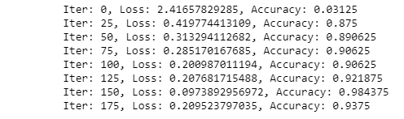
Running the Training
Code
Importing the Library
workspace.RunNetOnce(train_model.param_init_net)
workspace.CreateNet(train_model.net, overwrite=True)
total_iters = 200
accuracy = np.zeros(total_iters)
loss = np.zeros(total_iters)
for i in range(total_iters):
workspace.RunNet(train_model.net)
accuracy[i] = workspace.blobs['accuracy']
loss[i] = workspace.blobs['loss']
if i % 25 == 0:
print("Iter: {}, Loss: {}, Accuracy: {}".format(i,loss[i],accuracy[i]))
Loading the Data
Constructing the Model
Training the Model
Testing the Model
Deploying the Model
Running the Training

Slide 140
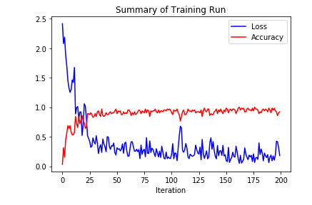
Running the Training
Code
Importing the Library
Loading the Data
pyplot.plot(loss, 'b')
pyplot.plot(accuracy, 'r')
pyplot.title("Summary of Training Run")
pyplot.xlabel("Iteration")
pyplot.legend(('Loss', 'Accuracy'), loc='upper right')
Constructing the Model
Training the Model
Testing the Model
Deploying the Model
Running the Training

Slide 141
Deep Learning Model with Python
Problem Statement: Make a deep learning model with Python.
Access:
Click on the Labs tab on the left side of the LMS panel. Copy the username and password.
Click on the Launch Lab button. On the page that appears, enter the username and password, and click Login.

Slide 142
Creating the Neural Network Class
Neural network consist of the following components:
An input layer, x
An arbitrary amount of hidden layers
An output layer, ŷ
A set of weights and biases between each layer, W and b
A choice of activation function for each hidden layer, σ. In this tutorial, you’ll use a Sigmoid activation function

Slide 143
Creating the Neural Network Class
Code
class NeuralNetwork:
def __init__(self, x, y):
self.input = x
self.weights1 = np.random.rand(self.input.shape[1],4)
self.weights2 = np.random.rand(4,1)
self.y = y
self.output = np.zeros(y.shape)

Slide 144
Creating the Neural Network Class
Adding backpropagation and loss function in the class NeuralNetwork
Code
def backprop(self):
# application of the chain rule to find derivative of the loss function with respect to weights2 and weights1
d_weights2 = np.dot(self.layer1.T, (2*(self.y - self.output) * sigmoid_derivative(self.output)))
d_weights1 = np.dot(self.input.T, (np.dot(2*(self.y - self.output) * sigmoid_derivative(self.output), self.weights2.T) * sigmoid_derivative(self.layer1)))
# update the weights with the derivative (slope) of the loss function
self.weights1 += d_weights1
self.weights2 += d_weights2

Slide 145
Creating the Neural Network Class
We are creating a Feed Forward function in NeuralNetwork class.
Code
def feedforward(self):
self.layer1 = sigmoid(np.dot(self.input, self.weights1))
self.output = sigmoid(np.dot(self.layer1, self.weights2)))

Slide 146
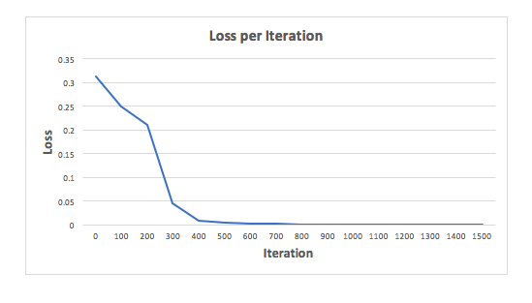
Output of the Neural Network
The loss of neural network after 1500 iterations:

Slide 147
Output of the Neural Network
Prediction after 1500 iterations:
Prediction | Y (actual)
0.023 | 0
0.979 | 1
0.975 | 1
0.025 | 0

Slide 148

You are now able to:
Explain and define deep learning models
Determine suitable loss function for deep learning models
Apply python to create a deep learning model without any deep learning framework
Build a deep neural network with Keras, Caffe, PyTorch, and Tensorflow deep learning framework

Slide 150
What is the minimum number of hidden layers a neural network should have to be qualified as a deep neural network?
1
1
2
3
All of the above

Slide 151
What is the minimum number of hidden layers a neural network should consists to be qualified as deep neural network?
1
1
2
3
All of the above
b
If a neural network contains one hidden layer it is called shallow neural network and a shallow neural becomes a deep neural network when one more hidden layer adds up.

Slide 152
Which of the following deep learning ecosystems does Glow, an ML compiler belong to?
2
PyTorch
Keras
Tensorflow
None of the above

Slide 153
Which of the following deep learning ecosystems does Glow, an ML compiler belong to?
2
PyTorch
Keras
Tensorflow
None of the above
a
Glow belongs to PyTorch ecosystem along with Skorch, Torchbearer, and PyTorch Geometric.

Slide 154
Which of the following loss functions is best suited to build a regression model with outlier?
3
MAE
MSE
Both MAE and MSE
None of the above

Slide 155
Which of the following loss functions is best suited to build a regression model with outlier?
3
MAE
MSE
Both MAE and MSE
None of the above
a
MAE is the suitable loss function to build a regression model with outlier while for a dataset without outlier it is MSE.

Slide 156
Which of the following deep learning frameworks uses Tensorflow backend?
4
Keras
PyTorch
Caffe
None of the above

Slide 157
Which of the following deep learning frameworks uses Tensorflow backend?s
4
Keras
PyTorch
Caffe
None of the above
a
Keras uses Tensorflow backend along with Theano and Mxnet.

Slide 158
Chars74k Image Classification
Problem Statement: Build a deep learning convolutional neural network to recognize characters using Chars74k dataset.
Objective: Build a neural network-based classification model to recognize characters using the following metrics:
Use 4 convolution layers with 3*3 kernel and activation function as ReLU. Add maximum pooling layers after every other convolution layer and 2 hidden layers with dropout.
Access: Click on the Labs tab on the left side of the LMS panel. Copy or note the username and password that are generated. Click on the Launch Lab button. On the page that appears, enter the username and password in the respective fields, and click Login.

Slide 159
Thank You

